Slide 1
Error detection & Error Correction

Slide 2
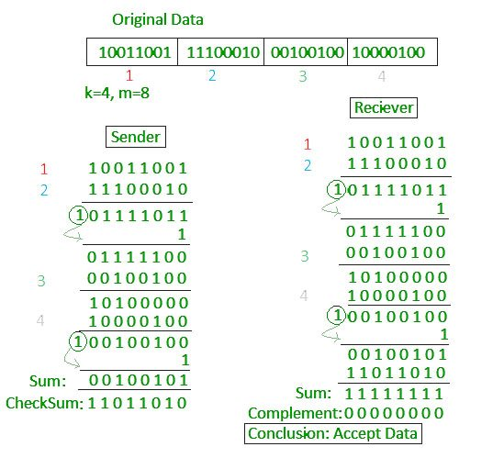
Checksum

Slide 3
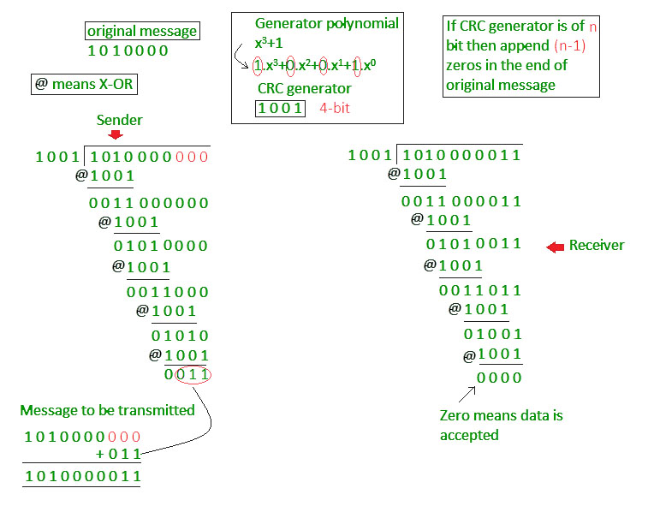
Cyclic Redundancy Check

Slide 4
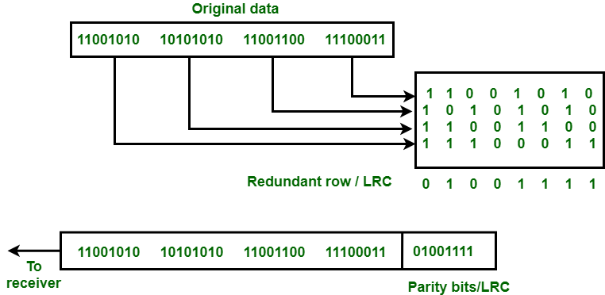
longitudinal redundancy check

Slide 5
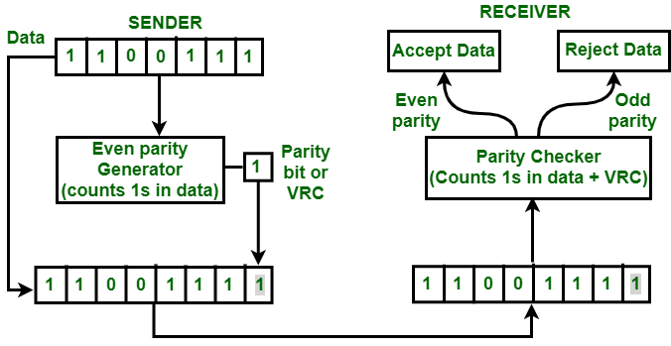
vertical redundancy check

